Slide 1
Overview of the Electromagnetics Group at Georgia Tech
Emag.gatech.edu

Slide 2
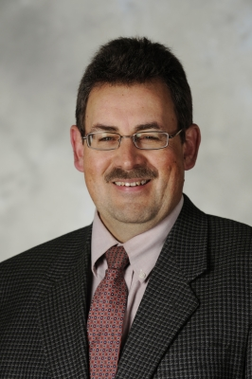
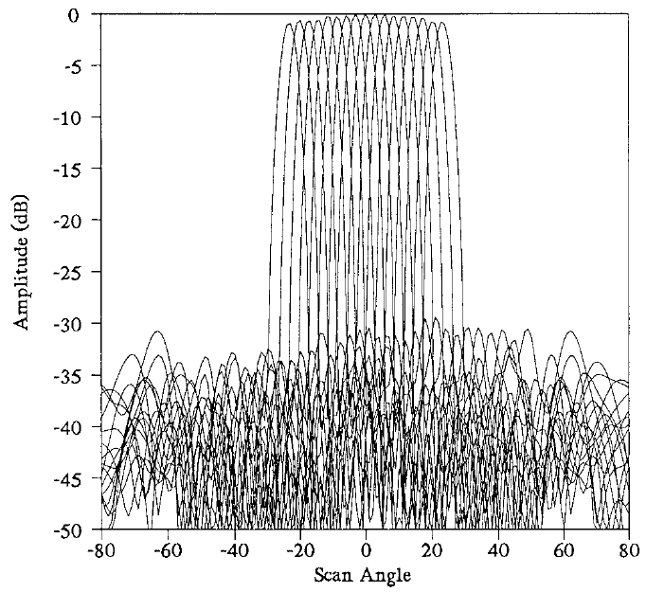
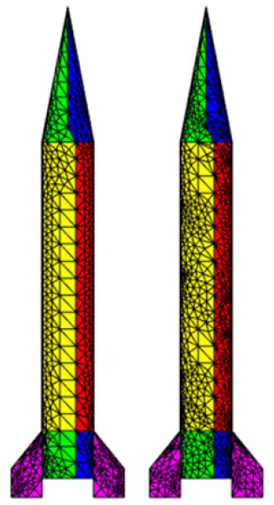
PETERSON Group
Research Areas:
Computational Electromagnetics
  Controlled accuracy computations
  Error estimation & adaptive refinement in integral equation formulations
Phased Array Antenna Design
  Rotman lens feed design & simulation
  Reflectarrays
  Direction of arrival algorithms
  Microwave & mm-Wave frequencies
Beam patterns from measured S-parameters for a 36.8 GHz Rotman lens design
Two surface meshes arising from an adaptive refinement solution procedure

Slide 3
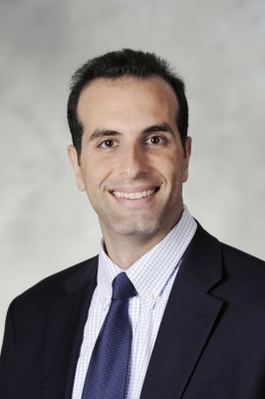
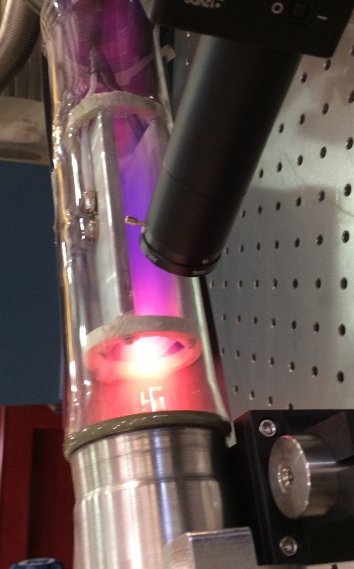
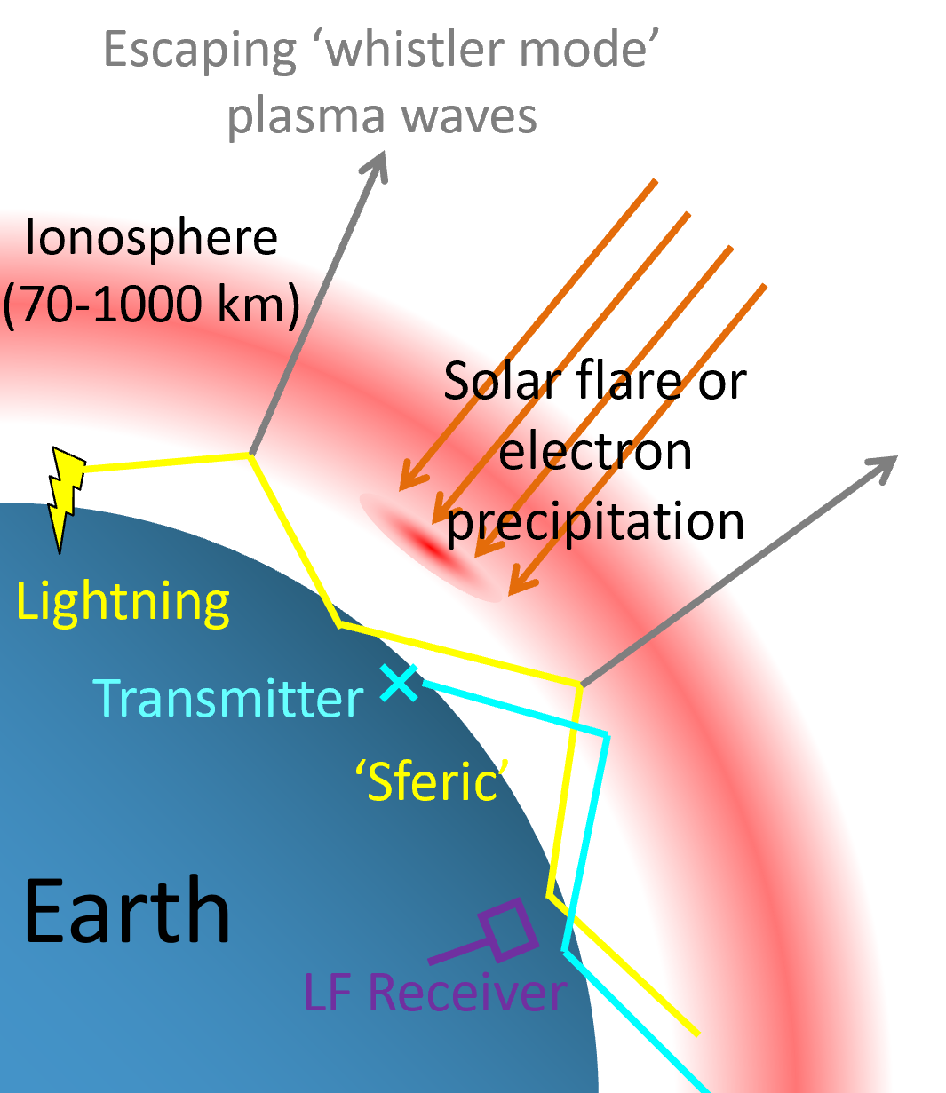
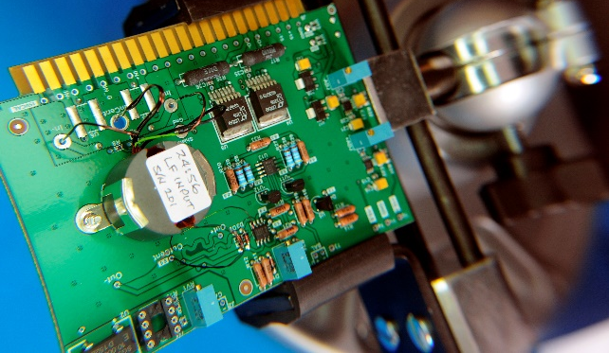
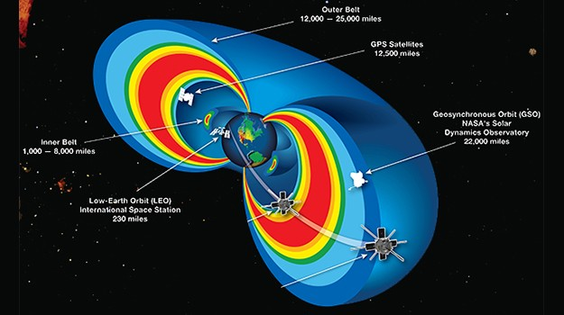
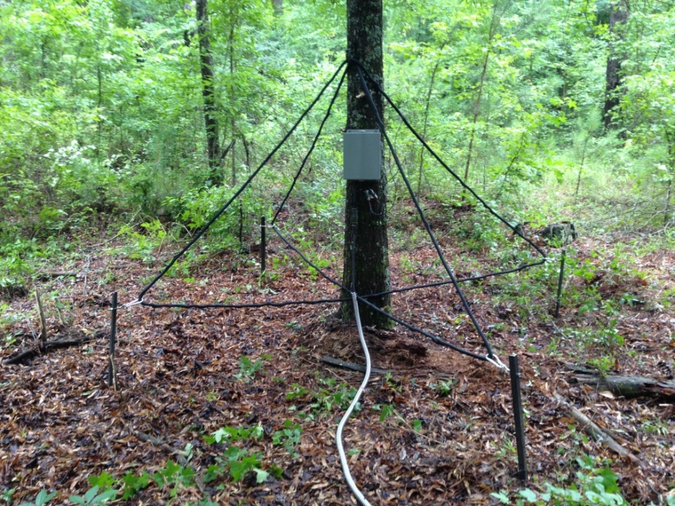
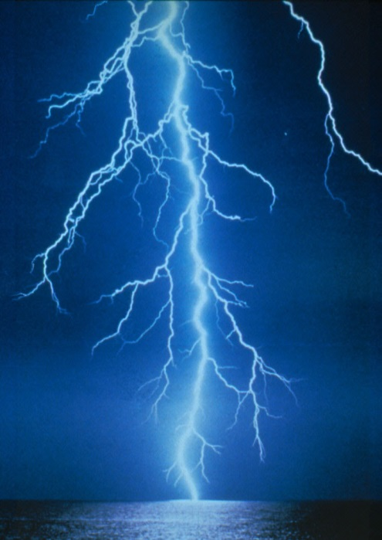
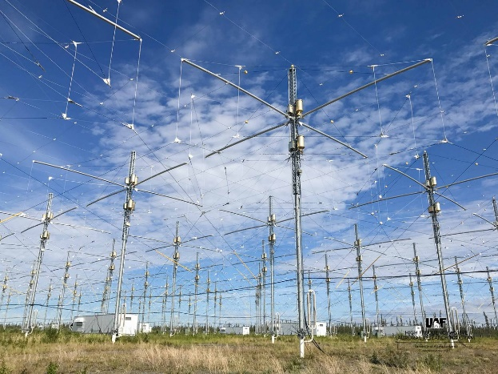
Cohen Group
Research Areas:
Science
Engineering
LF Radio Group: http://lf.gatech.edu
  Lightning and plasma physics
  Ionospheric remote sensing
  Space weather
  Global comms and navigation
  Subsurface and subsea mapping
  Power grid cybersecurity
  Satellite protection
  Broadband electrically short antennas

Slide 4
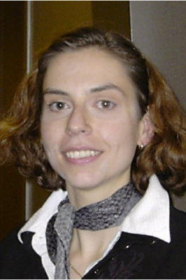
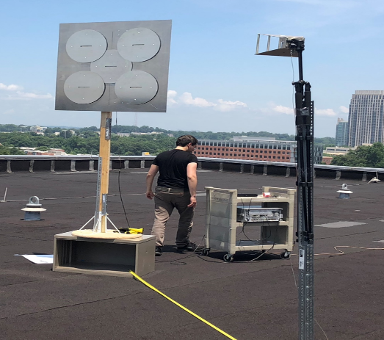
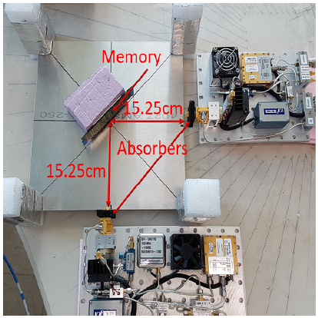
ZAJIC Group
Website/Faculty Profile:
www.ece.gatech.edu/~alenka
Research Areas:
Measurements and Modeling of EM Emanations from Electronics with Applications in Cybersecurity
Measurements, Modeling and Prediction of wireless propagation in challenging environments (vehicle-to-vehicle, underwater, chip-to-chip, high frequencies)
Antenna and Probe Design
Antenna range measurements
THz Chip-to-Chip Measurements
RSA Crypto-breaking
Hardware Trojan Detection
Various activities in EMC^2 Lab

Slide 5
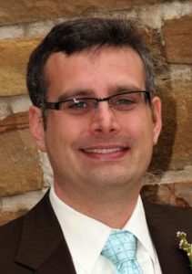
Durgin Group
Research Areas:
Propagation Modeling
Wireless Power Transfer and Harvesting
Radiolocation/Motion Capture
Backscatter Communications and RFID
Antenna Design
Propagation Group: www.propagation.gatech.edu
Cut-away diagram of a 5.8 GHz backscatter sensor and reader system designed and built at Georgia Tech to be deployed on a CubeSat mission with NASA/Northwest Nazarene University

Slide 6
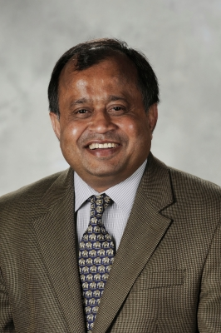
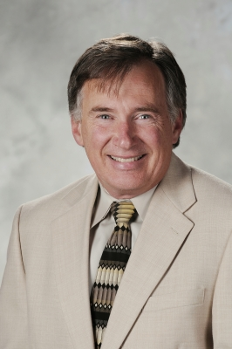
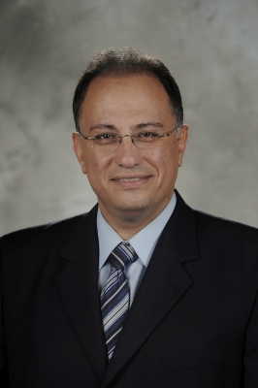
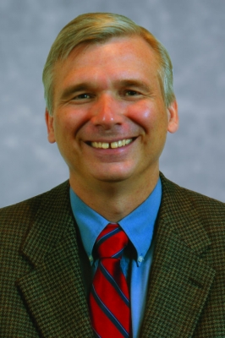
Other GroupS in GT EMAG
Swaminathan Group:
Packaging, RF Devices
Steffes Group:
Remote Sensing, Space Missions
Tentzeris Group:
Radiolocation/Motion Capture
Scott Group:
Remote Sensing, Buried Object Detection

